Slide 1
Regression Compactor
About Optimization
Malli, Sarada, Prasad
29-Feb-2016

Slide 2

Background
Shire Base Regression testing is a unique testing across all ADTRAN products (TA5Ks, OSPs, NCTEs) and used by different groups such as DVT, SMOKE, SBT.
What we are doing
CLI
Traversal, Walk, Syntax, TACACAS, DBError Check
Alarm
CLI, SNMP V2, SNMP NB V1, SNMP NB V2, AOE, TL1, TL1 NB, Web, Syslog, AUTONOMOUS
RESTConf
Generate different RESTConf URIs from a YANG model
iTest Response maps
RESTConf
2 Not Committed Yet
59 John Thomas Wile II
135 jtwile2
3723 Mallikarjunarao
SHIRE/P4
GEN XML/YANG
XML/YANG Push
LOAD
Testing
Issues
SANITI
sBT
Ubuntu, MS SQL, ADTRAN units
and SANITI
Lines of code 8,78,740
Few Authors
4,24,687 cfortier
2,71,991 twile
82,935 vkosuri
DEV./
DVT.
Notes:
SANITI - Simply Amazing Network Integrity Test Interface
\\corp-bs7

Slide 3




Common Problems
Analyzing failures very difficulty because large number of failures, look into different log files, find right issue
/var/logtacacs_acs.log
/var/log/snmptrapd.log and Total 9 log files are there
Average log file size is ~2 MB text file
When other groups are trying to use our test scenarios they have to be aware few parameters that will effect regression
Lack of notification when something went bad
By nature regression requires recorded documentation for failures/regression/etc

Slide 4
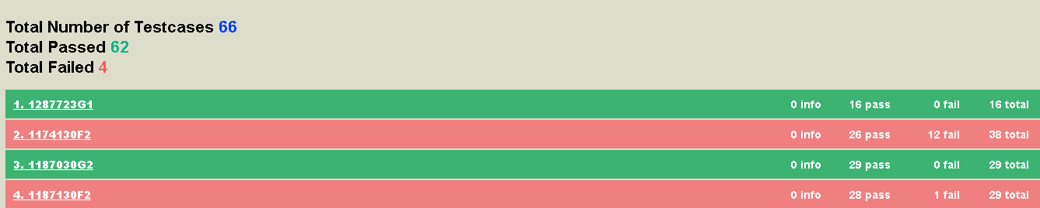
Solution
SANITI Web logger
Provides web tail –lf access to different log files from your browser.
ALM Compactor
A testcase which will run from HP ALM provide a consolidated report in html format
ALM Compactor
Compactor Testcase
Notes:
http://10.49.236.44:8181
file:///C:/Users/vkosuri/AppData/Local/Temp/compactLogs/htmlLogs/ResultXML_23022016_175823.html

Slide 5
Solution CONTI…
Notification
Reboot happened
Lost session
Automatically add each SwitchTo and it’s ‘no’ version to syntax skips
Adding skip command-sets to overcome reboot issue
Alarm Pre-Provision
Unset and set again all trap host

Slide 6

Expected Big savings
Regression | Number of Failures | Identify Failure (MINS) | Analyze Failure
Traversal | ~ 2 | 5 | 10
Walk | ~ 10 | 5 | 50
Syntax | ~ 25000 | 0.3 | 7200
Alarm | ~ 100 | 10 | 1000
8260 Mins i.e ~ 6 Days
3022 Mins i.e ~ 3 Days
The values are per test set
Regression | Number of Failures | Identify Failure (MINS) | Analyze Failure
Traversal | 2 | 1 | 2
Walk | 10 | 2 | 20
Syntax | 25000 | 0.1 | 2500
Alarm | 100 | 5 | 500

Slide 7





tools
ALM OTA

Slide 8

Questions

